Slide 1


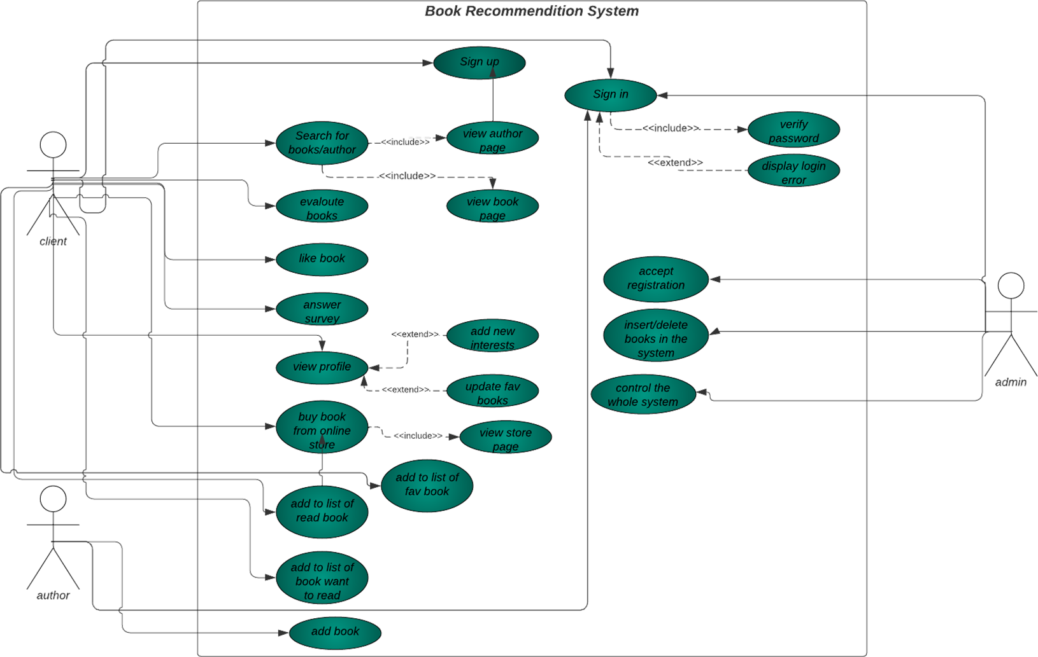
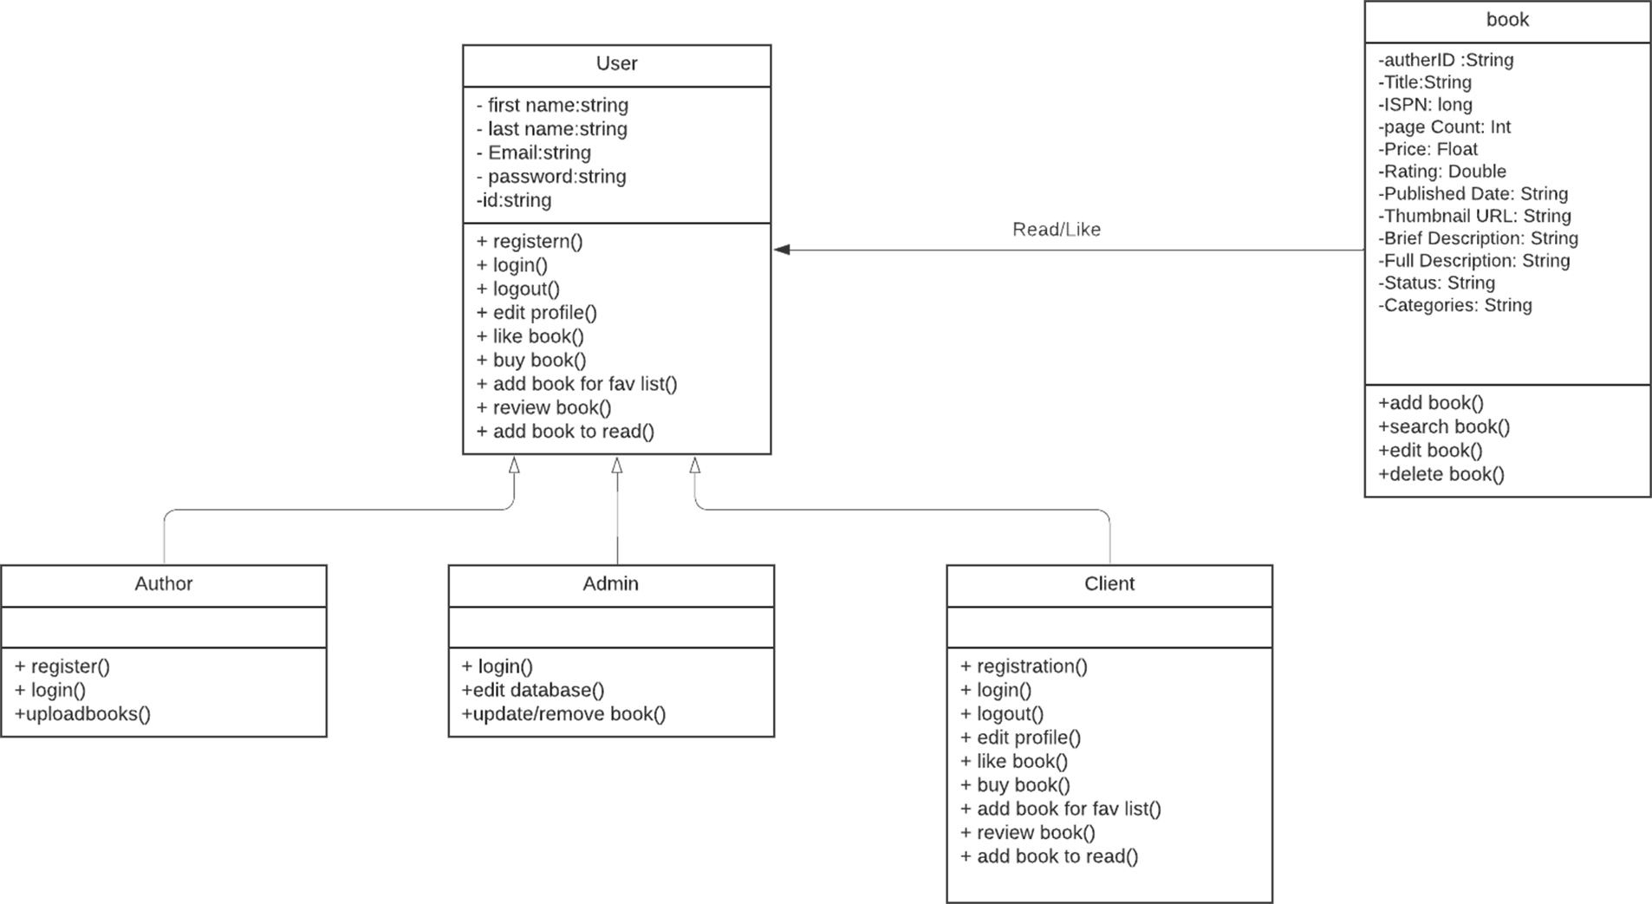
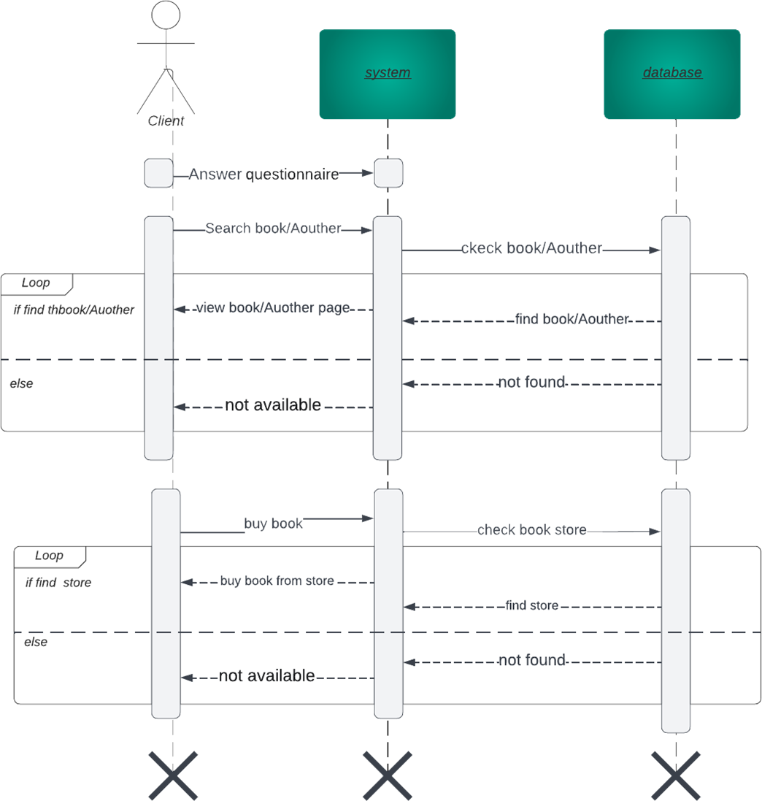
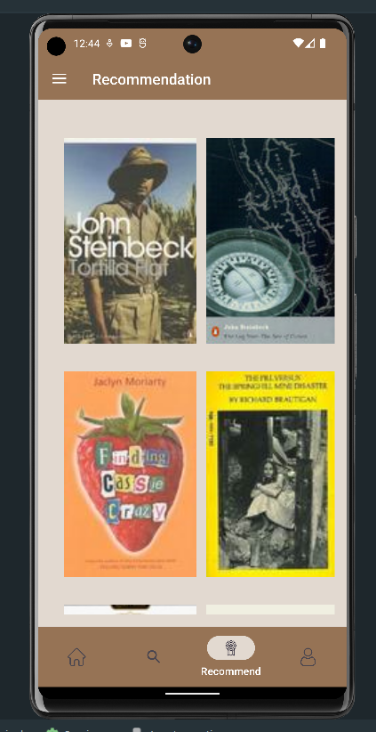
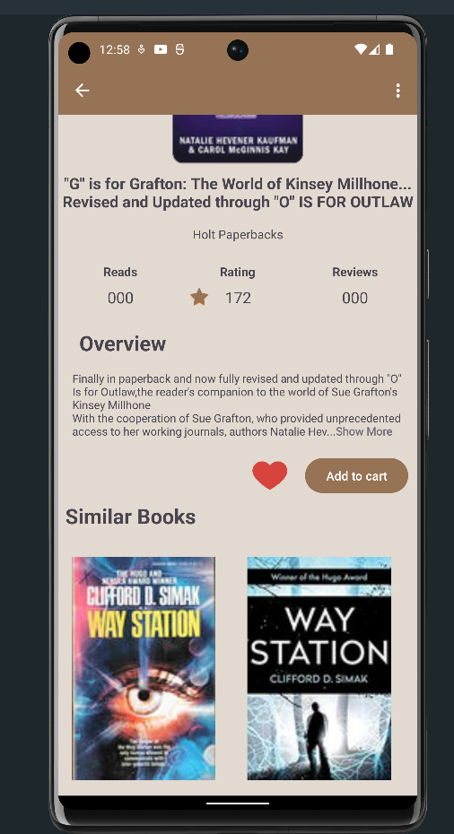
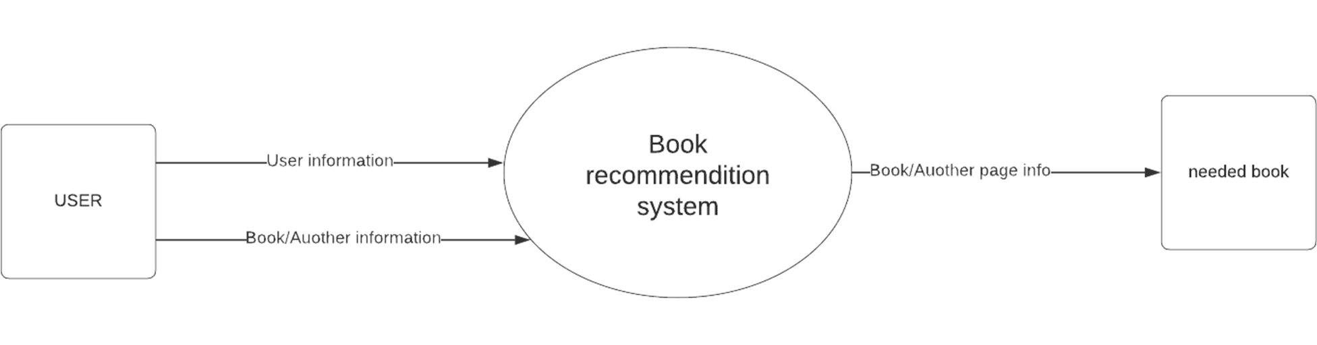
Books Recommendation System
InkReader
Youssef Maged , Ahmed Essam , Moaaz Ismail , Nour Elmergawy ,
Amr Ashraf , Sara Hesham , Mohamed Nagi , Maryam Ebrahim
Abstract
Methods
Expectation Result
Conclusion
This abstract describes a mobile app that recommends books to users based on their reading preferences. The app is designed to provide a personalized reading experience, with a user-friendly interface that makes it easy to find and discover new books.
The app uses a sophisticated algorithm that takes into account the user's reading history, genre preferences, and ratings of previous books to generate recommendations. Users can also browse through curated lists, such as "New Releases" or "Bestsellers," or search for specific titles or authors.
The app includes a social aspect, allowing users to connect with friends and share book recommendations. Users can also create their own reading lists and track their progress as they read.The app includes features such as book summaries, reviews, and ratings from other users, as well as links to purchase books directly from the app. It also offers personalized recommendations for audiobooks and e-books, making it a comprehensive reading companion for users on the go.
Overall, this book recommendation mobile app is an essential tool for book lovers who want to discover new titles and connect with other readers. With its intuitive design and personalized recommendations, it is sure to become a go-to resource for anyone looking to expand their reading horizons.
In the era of digital content consumption, finding the right book to read can be overwhelming due to the vast amount of available options. Our project aims to develop a book recommendation system using unsupervised machine learning techniques. This system will be applied to a mobile app to enhance the user experience by providing personalized book recommendations for both new and existing users.
Use-Case Diagram
Class Diagram
Sequence Diagram
Context Diagram
Tools
Python.org
Scikit-learn
Android Studio
Node.JS
Flask
Mongo DB
Mongoose
ExpressJs
This section lists the functional requirements used for creating the test-case table, the test cases that were used to verify the interface table, and the results for the test-cases table. the table include test case and his Test results
This section lists the results that were produced by running the test cases.
This table lists the test cases that were used while testing the interface
along with the expected result and the actual results for each test case
This Figure shows our recommendation books
In conclusion, a book recommendation system is a valuable tool that helps users discover new books tailored to their interests and preferences. By analyzing user behavior, such as reading history and ratings, the system can generate personalized book recommendations that are likely to resonate with individual users. This technology has revolutionized the way people find and consume books, making it easier than ever before to explore new genres and authors.
In addition to offering personalized recommendations, a book recommendation system can also provide valuable insights into user behavior and preferences. These insights can help publishers and authors better understand their audiences and create content that is more likely to connect with readers.
Overall, a book recommendation system is an essential tool in the modern publishing industry. By harnessing the power of data analysis and machine learning, this technology is helping to shape the future of reading and empowering readers to discover new books that they might not have otherwise found.
Functional Requirement Number | Test Case Number | Test Case Short Description
R1 | T1 | Verify the email address of the user.
 | T2 | Login to the application.
 | T3 | User can view all books
 | T4 | User can interact with book
 | T5 | User can buy book
 | T6 | User can search for a book
Reference
1. http://www.agilemodeling.com/artifacts/dataFlowDiagram.htm
for definition of Data Flow Diagram.
2. https://www.nodejs.org/en/docs for information about Node.js
3. https://www.expressjs.com for information about Express.js
4. https://www.mongodb.com/docs/ for information about MongoDB
5. https://mongoosejs.com/docs/ for information about Mongoose
6. cs.github.com/en for information about GitHub
Test Case Number | Expected result | Actual result
T1 | Pass | Pass
T2 | Pass | Pass
T3 | Pass | Pass
T4 | Pass | Pass
T5 | Pass | Pass
T6 | Pass | Pass
objectives
The purpose of this document is to provide a detailed description of the requirements for the Book Recommendation System Mobile App. This app aims to suggest books to users based on various factors, including their preferences, reading history, and book popularity. By leveraging unsupervised machine learning techniques, the app refines recommendations over time, offering personalized suggestions that enhance the reading experience and help users discover new books aligned with their interests.
This document covers the requirements for the Book Recommendation System Mobile App, including the overall description, specific requirements, and supporting information. The app is designed to serve readers looking for book suggestions across various genres, formats, and categories, as well as authors and publishers seeking to promote their books to a broader audience.
In today's digital age, readers have access to a vast assortment of books, spanning various genres, formats, and categories. While this abundance of choices is generally positive, it can also make it challenging for readers to find books that align with their preferences and interests. Furthermore, authors and publishers face increased competition to capture the attention of readers, leading to a need for effective book promotion and discovery tools. According to recent statistics, the literacy rate in Egypt has shown a decline. In 2017, the literacy rate was 71.17\%, a 1.27\% decrease from 2013. This decline highlights the need for effective, flexible, and versatile tools to encourage people to read and recommend valuable books for those who are already readers. The goal is to upgrade the readers' community, which will contribute to improving and enlightening society. Machine learning-based recommendation systems have gained popularity in recent years due to their ability to analyze large datasets and identify patterns to provide personalized suggestions. These systems have been successfully implemented by major online retailers and content platforms to improve user engagement and satisfaction. The Book Recommendation System Mobile App seeks to address these challenges by providing a tailored reading experience for users, leveraging unsupervised machine learning techniques to suggest books based on users' preferences, reading history, and book popularity.
Acknowledgement
We would like to express our deepest appreciation and gratitude to the faculty members who have played an integral role in our academic journey. Their dedication, knowledge, and support have been instrumental in shaping our education and fostering our personal and professional growth. We would like to extend our heartfelt thanks to each faculty member for their invaluable contributions.
First and foremost, we would like to acknowledge our professors for their commitment to excellence in teaching. Their passion for their respective subjects has ignited our curiosity and instilled in us a thirst for knowledge. Their ability to effectively communicate complex ideas and concepts has made learning a truly enriching experience. We are grateful for their patience, guidance, and willingness to go the extra mile to ensure our understanding and success.
We would also like to recognize the efforts of our mentors and advisors who have provided us with invaluable guidance and support throughout our academic journey. Their wisdom, expertise, and willingness to share their experiences have been instrumental in shaping our career paths and helping us navigate through challenges. Their commitment to our personal and professional development has been a constant source of inspiration.
Furthermore, we extend our gratitude to the faculty members who have gone beyond their roles as educators by fostering a positive and inclusive learning environment. Their efforts to create a sense of belonging, encourage open dialogue, and embrace diversity have made our educational experience truly enriching. We appreciate their dedication to promoting respect, understanding, and collaboration among students from various backgrounds.

